Slide 1
Old Lee Highway Multimodal Improvements
JUNE 2021

Slide 2
Today’s Agenda
Presentation of staff recommended Major Design Features package of improvements
Request for Council endorsement of Major Design Features at July 13 City Council meeting

Slide 3
Major Design Features Staff Recommendation
Roundabout at Ridge Avenue/OLH Intersection
Roundabout at Country Hill Road/OLH Intersection
Left Turn Lane from NB OLH to Sherwood Center
St. Leo’s/Daniel’s Run Access Management Improvements
Provide Left Turn Lane from SB OLH to Daniel’s Run Entrance
Consolidate & realign northern entrances to St. Leo’s (Coordination Ongoing)

Slide 4
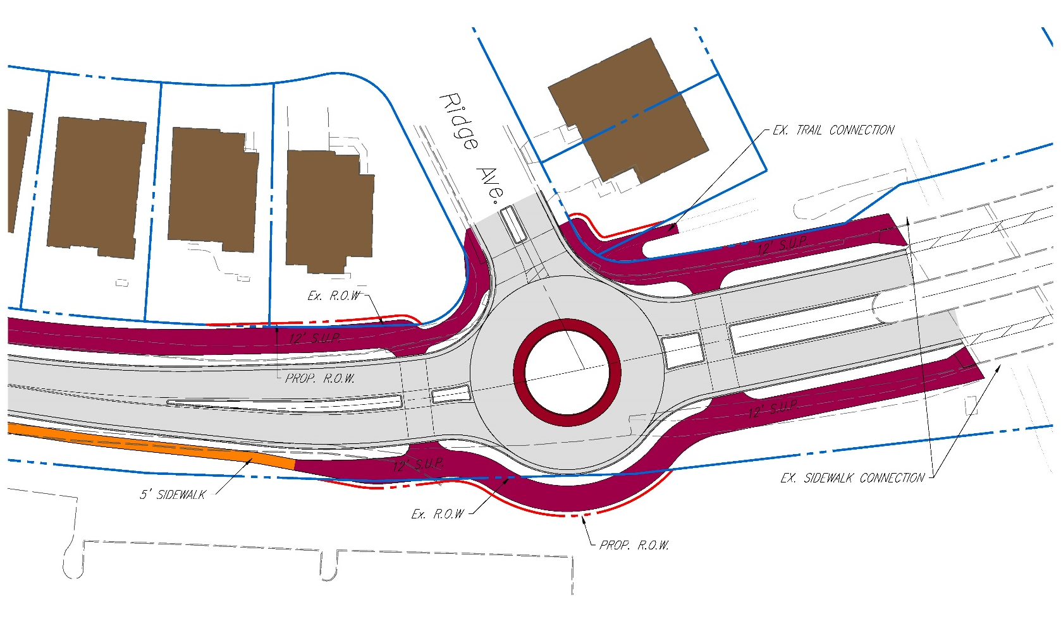
Ridge Avenue Roundabout
Improves neighborhood ingress/egress to Ridge Avenue
Accommodates U-turn movements for traffic from Fairfax Shopping Center
Improves bike/ped crossings & connectivity
Provides gateway to OLH
Reduces vehicular speeds

Slide 5
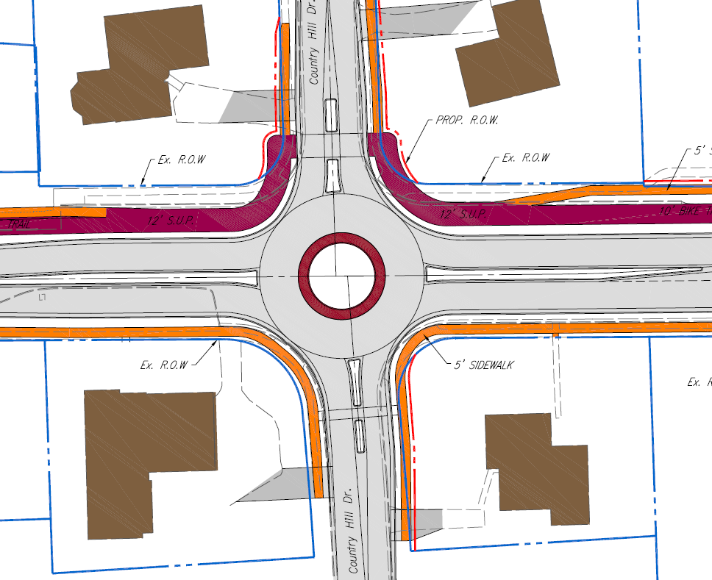
Country Hill Drive Roundabout
Provides improved neighborhood ingress/egress to both sides of OLH

Slide 6
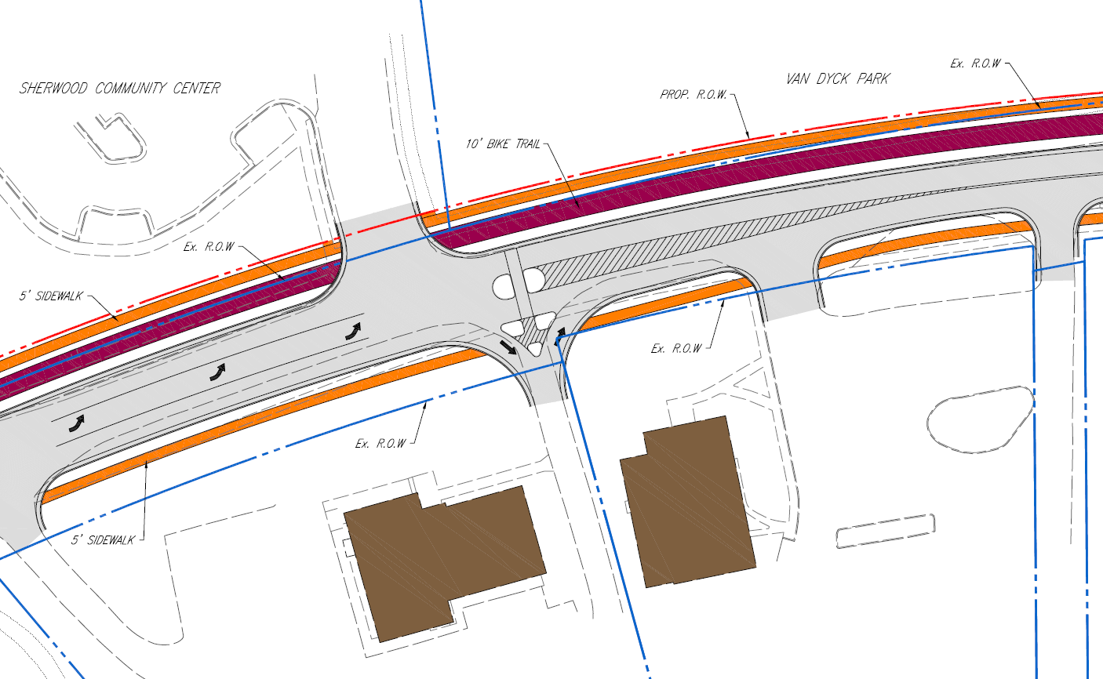
Left Turn Into Sherwood Center
Serves Sherwood Center & Future Redevelopment
Relocates & Improves Pedestrian Crossing
Converts 2nd Mennonite Church Entrance to Right-In/Right-Out
Eliminates conflicts with Sherwood/OLH intersection

Slide 7
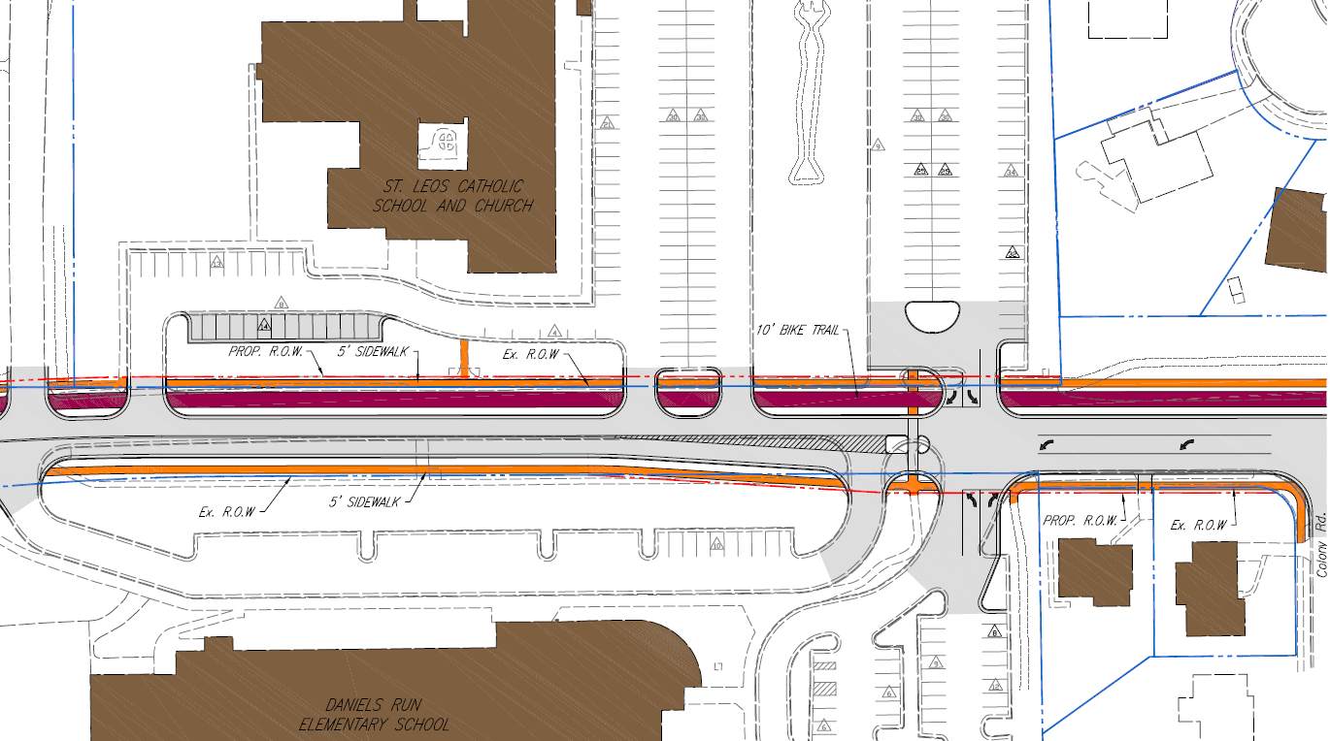
St. Leo’s / Daniel’s Run Access Management

Slide 8
St. Leo’s / Daniel’s Run Access Management
Complex Traffic Issues Impacting OLH During School Arrivals/Dismissals
Cannot be “solved” without significant access management restrictions, road widening, and major school site modifications
Staff Recommendation improves some traffic & safety issues
Staff Recommendation Based On:
Extensive Stakeholder Input
Engineering Analysis Including Traffic Modeling & Field Observation
Alternatives Screening Using Primary Project Design Considerations

Slide 9
St. Leo’s / Daniel’s Run Access Management
Key Factors in Developing Recommendations
Traffic & Pedestrian Data
Left turn movements into Daniel’s Run significantly higher than left turn movements into St. Leo’s
(AM- 45vph versus 15vph, PM 30vph versus 5vph)
90 pedestrian crossings (AM) 230 pedestrian crossings (PM)
Optimal location for crosswalk to Daniel’s Run
Current location is best (if driveways are consolidated)
Alternative includes longer OLH crossing and longer route to school front door
Safety Benefits
Improves pedestrian safety
Reduces vehicle/pedestrian conflict points
Improves crossing guard ability to control intersection
Congestion Mitigation Benefits
Aligned entrances allow concurrent exiting of vehicles from St. Leo’s & Daniel’s Run (shortens OLH stoppage times)
Turn lane into Daniel’s run reduces traffic impacts from left turns after crossing guard stoppage

Slide 10
Next Steps
July 13, 2021 - Council Resolution endorsing Major Design Features
Community engagement will continue as project progresses
Formal Public Hearing (No Council Action) at ~60% Design
Right of Way Acquisition (May require Council action for City-owned parcels)
Award of Construction Contract (Council Action)

