Slide 1
Strategic Master Planning Process for City Parks, Recreation, Trails, Open Space, Events and Cultural Activities
Public Workshop #3: Facilities
Indoor Spaces, Aquatic Facilities & the Future of Green Acres
Saturday, June 22, 2013 - 10 AM to noon

Slide 2
Agenda
Welcome and Overview
Inventory of Current Programs & Facilities
Summary of Community Input Received To-Date
Priority Programs & Services – Recreation Center, Senior Center, Indoor/Outdoor Aquatics
Decision Making Criteria
Future of Green Acres
Wrap-Up
Notes:
PRAB Chair or Director welcomes participants and introduces consultants
Consultants introduce themselves further, outline desired outcomes, agenda, and flow of meeting

Slide 3
Meeting Purpose and Outcomes
Collect more detailed community input on park and recreation facilities
Identify priority programs and services offered in indoor spaces and aquatic features/facilities
Identify decision making criteria for determining where and how services are provided
Generate specific ideas for the future of the Green Acres site
Notes:
Consultants outline desired outcomes, agenda, and flow of meeting

Slide 4
What is the Strategic Plan?
What is it?
  A clear, concise and measureable set of goals, policies and objectives
For what purpose?
  To provide direction to the City Council, Staff, Parks and Recreation Advisory Board and Commission on the Arts
How will it be used?
  To inform decision making related to the future development, redevelopment and enhancement of the City’s parks system, open space, recreation facilities, act ivies, events and services.
Notes:
Consultants provide BRIEF overview of planning process.

Slide 5
What will it include?
Development of a comprehensive inventory, an analysis of current and forecasted needs and implementation strategies
Parks System, Open Space and Trails
Recreation Facilities
Recreational/Cultural Activities, Events and Services
Capital Development
Costs and Funding Sources
Notes:
Consultants provide BRIEF overview of planning process.

Slide 6
Why are we doing this now?
Significant change in our City…our residents…our users’ needs…the ways people recreate…and the requirements and impact to our natural environment
Economic conditions forced deferral of capital maintenance and replacement…built up needs require comprehensive and objective evaluation
Strategic Plan will help identify trends and needs in the community and how we will meet them
Notes:
Consultants provide BRIEF overview of planning process.

Slide 7
What is the scope of this plan?
Two Phase Approach
Phase I: Strategic Vision
  ENGAGE the community in a variety of interactive public participation processes
  Identify WHAT citizens and City Council want and will support
  Establish clear and concise VISION, GOALS and OBJECTIVES
Phase II: Strategic Action Plan
  Action steps to answer WHO, WHERE, WHEN and HOW to implement the Vision
Notes:
Consultants provide BRIEF overview of planning process.

Slide 8
What are the Phase I deliverables?
4 public workshops
20 stakeholder meetings
3 reports
Online civic engagement
Statistically valid survey
Preliminary park classification definitions
Preliminary levels of service
Notes:
Consultants provide BRIEF overview of planning process.

Slide 9
Who is involved?
Bottom line…EVERYONE in the community
Led by PRAB and staff…advised by Steering Committee sounding board…facilitated by professional planning consultants
Community-wide input process – residents, “users,” participants, business, special interest groups…etc.
Partners – George Mason University, Fairfax County Park Authority, Northern Virginia Regional Park Authority
Notes:
Consultants provide BRIEF overview of planning process.

Slide 10
Current Inventory – Indoor Spaces & Aquatics
City Parks & Recreation | Other City Resources | Surrounding Area
Green Acres Center Sherwood Community Center Blenheim Civil War Interpretive Center Old Town Hall | Fairfax High School Providence Elementary Daniels Run Elementary Lanier Middle School | Oak Marr RECenter Cub Run RECenter Providence RECenter Audrey Moore RECenter Fairfax Senior Centers Fairfax County Community Centers Neighborhood Pools Country Club Hills Mosby Woods Fairfax Swimming Pool GMU RAC GMU AFT Fairfax County Water Mine at Lake Fairfax
Notes:
Consultants provide quick overview of the current inventory of indoor recreation facilities used by City residents.
City owned recreation facilities
Other City facilities
Other facilities in surrounding area (GMU, FCPA, etc.)

Slide 11
Summary of Input Received
Input received through public workshops, stakeholder meetings, and Our Parks. Our Future
Recreation center
  In conjunction with a senior center
  Fitness machines / cardio area
  Walking track
  Game courts
  Lap / competition pool
  Therapy pool
  Indoor playground
Notes:
Consultants review most significantly recurring input received to date through the public workshops, stakeholder meetings and online. Explain that this workshop is designed to collect more detailed input on these theme areas.

Slide 12
Summary of Input Received
Input received through public workshops, stakeholder meetings, and Our Parks. Our Future
Senior center
  Wood dance floor
  Located on the CUE
  Larger fitness area/more machines
  Therapy pool
  Kitchen
  Adult restrooms
  Pool, sauna, steam room
  Wellness center
  Garden
  Computers
  TV area
  Transportation
  Programming
  Indoor track
  Paved parking
  Accessible – easy to find
Notes:
Consultants review most significantly recurring input received to date through the public workshops, stakeholder meetings and online. Explain that this workshop is designed to collect more detailed input on these theme areas.

Slide 13
Summary of Input Received
Input received through public workshops, stakeholder meetings, and Our Parks, Our Future
Indoor / Outdoor Aquatics
  Indoor pool for competition and lap swimming
  Therapy pool
  Splash pads at parks
  Outdoor family aquatic center
Notes:
Consultants review most significantly recurring input received to date through the public workshops, stakeholder meetings and online. Explain that this workshop is designed to collect more detailed input on these theme areas.

Slide 14
Public Workshop Priorities
Voting with Dollars - $1,000 each participant
Develop new or improved senior center facilities - $16,200
Improvements/maintenance of existing parks, playgrounds,
game courts and picnic areas - $15,000
Development of a new outdoor family aquatic center - $13,000
Development of new walking and biking trails - $10,800
Improvements/construction of new athletic fields - $10,000
Development of new indoor recreation facilities - $8,400
Acquisition of land for open space/green space/future park land $7,850
Development of new outdoor Parks and Recreation Facilities - $5,550

Slide 15
Public Workshop Priorities
Voting with Dollars - $1,000 each participant
Other:
Bigger skate park - $2,150
Roller/hockey rink - $1,000
Dog park - $1,000
Blank - $850
Festival center - $450
Edible landscape - $450
Community garden - $400
Programming - $350
Improve parking/access
to Thaiss Field - $200
More tennis courts - $200
Swings for adults - $150
Nature Center - $150
Golf facility - $100
Cultural events at
Sherwood - $100
Good dance floors - $100
Control Invasive plants - $50
Sidewalks - $50
I-66 Overpass - $50
Asphalt track - $50
Space for arts/City Band
office - $50

Slide 16
Priority Programs and Services
What are the priority programs and services needed at an indoor recreation center, senior center and indoor/outdoor aquatic facility?
Indoor Rec
Center
Senior
Center
Indoor/Outdoor Aquatics
Notes:
Instruction for participants:
The City would like your input on the priority programs and services that would be featured at an indoor recreation center, a senior center and indoor or outdoor aquatic facility. To do this, we will break into three groups, each assigned one of these three topics.
At this time we ask that you identify which of the three topic areas are of most interest to you. Everyone will have an opportunity to comment on all three areas, however for the small group work we ask that you identify one area of particular interest. There are three areas designated for discussion – move to the table that represents your interest area. Once you move, we will provide further direction.
Now you are at your discussion tables, you see that you each have a stack of 5x7 index cards. The first assignment is an individual one – we ask that you work by yourself and write down the programs/services (one per card) you feel are the greatest priority for your particular topic (rec center, senior center, etc). Once you complete your individual work, the table facilitator will guide your group through a discussion and prioritization exercise. In the end, each group will post their agreed upon priorities at the front of the room and we will discuss as a full group.

Slide 17
Decision Making Criteria
When planning for investments related to indoor spaces, what decision making criteria should the City use?
Examples:
Use existing facilities
Renovate existing facilities
Build new facilities in the City
Partner with others to build new facilities
Etc.
Notes:
The City would like your input on the type of decision making criteria that should be used when making the tough decisions related to planning indoor recreation facilities. In this next exercise, the table facilitators will guide a group discussion to identify the decision making criteria you feel are most important.
Consultants set up next exercise by explaining the need for decision making criteria that the City may use in future planning processes; what is most important to guide decision making? (use existing facilities, renovate existing, build new in the city, partner to build new, partner to gain access to other spaces, independent facilities, co-locate facilities, etc.)
Consultants ask each group to brainstorm and chart criteria
Consultants ask each group to share with the large group

Slide 18
Green Acres – Future Use
What are your ideas for the best use and future of Green Acres?
Notes:
Consultants set up discussion to identify ideas for the future of Green Acres facility
Consultants facilitate large group discussion and charting of ideas for the future of Green Acres

Slide 19
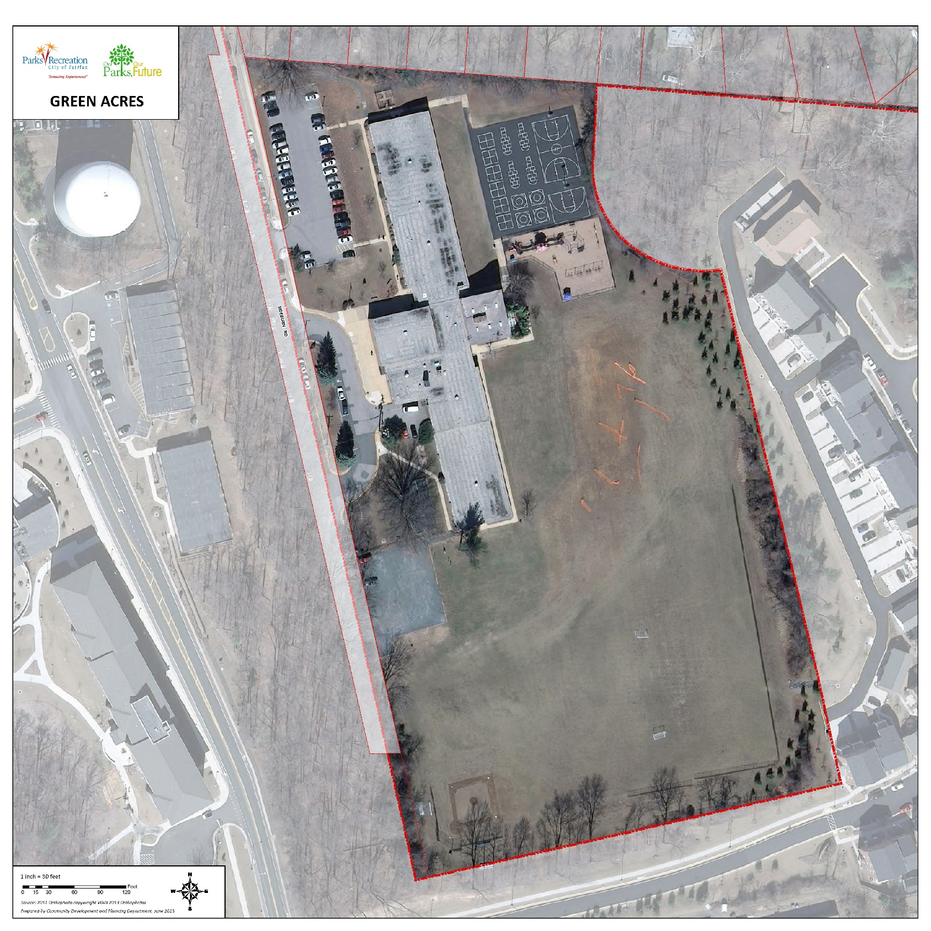

Slide 20
Phase I Timeline
Mar | Apr | May | Jun | Jul | Aug | Sep | Oct
Steering Committee Meetings | 3/20
Mind Mixer Kick Off |  | 4/1
Public Workshops |  |  | 5/2-3 | 6/22-23
Prior Studies, Demographic, Inventory, and Trends
Stakeholder Meetings |  |  | May | June
Needs Assessment Survey |  | April | May | June | July
Public Workshop |  |  |  |  |  | Mid Aug
Mission, Vision, Goals, Objectives |  |  |  |  |  | Late Aug
Final Presentations |  |  |  |  |  |  | Sep
Ongoing Public Review Comments
Notes:
Consultants will summarize overall timeline…what happens next…and how participants may remain involved.

Slide 21
Closing Thoughts/Comments
Notes:
Consultants will ask for any closing thoughts, comments and questions. Thank participants for attending.

