Slide 1
A MANAGEMENT GUIDE FOR
invasive
species
FOR NEIGHBORHOOD GROUPS OF THE CITY OF FAIRFAX
CITY OF FAIRFAX | URBAN FORESTRY MANAGEMENT PLAN | INSTITUTE FOR A SUSTAINABLE EARTH (GMU)
ANNA SAFFORD | MELISSA PENNETT | LEAH SATTLER

Slide 2
1. PROJECT SCOPE
Why are invasive species important? What is this project doing to help?
2. SURVEY
agenda
What do neighborhoods have to say about invasive species?
3. DELIVERABLES
How can we provide the most efficient tools?
4. FEEDBACK
What suggestions do you have?

Slide 3
scope
of project
Invasive species management has both environmental and economical benefits

Slide 4
scope of project
Current awareness of invasive plants in neighborhoods:
Many city members self-identify as familiar with managing and removing invasives
Critical to get the right tools in their hands

Slide 5
scope of project
Purpose of project:
Increase awareness of invasive plants and the importance of their management
Assess what tools and deliverables are most needed to manage invasive plants
Provide deliverables which will assist neighborhood groups across the City of Fairfax with invasive plant management

Slide 6
scope of project
2 parts to project:
survey + deliverables
tells us what people know
informs how we can provide support
reveals where & why people are interested in helping
provides real materials to assist in invasive plant management
offers opportunities for community building

Slide 7
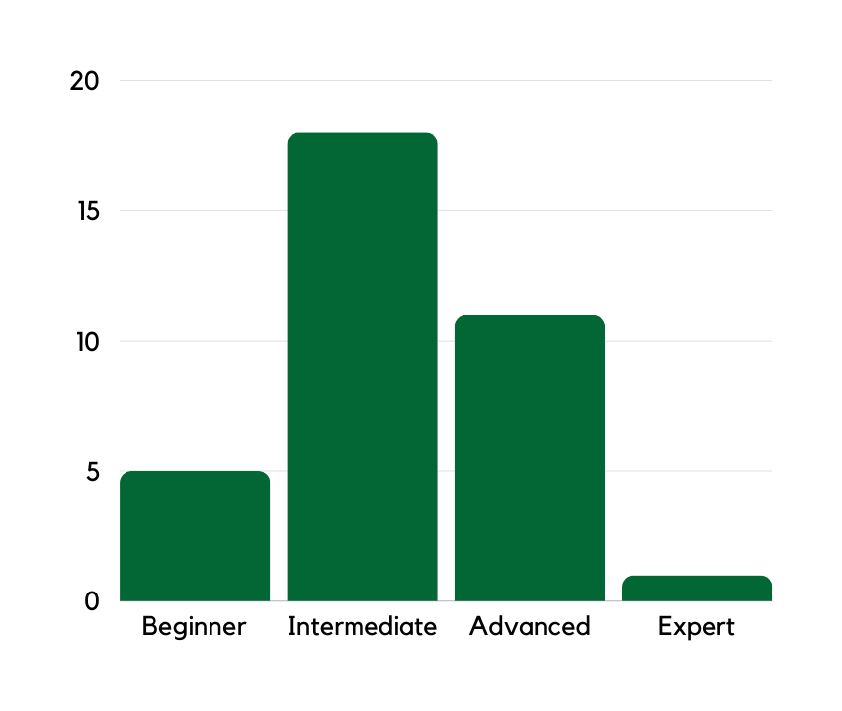
“How you you describe your invasive plant knowledge?”
survey
What are we looking for, and what have we found so far?

Slide 8
survey
1. Self-identification
How would you describe your knowledge of invasives?
Are you aware of any invasives in your own yard?
Do you live in an HOA/neighborhood group?
How does your neighborhood share information?
2. Tools
Do you feel you have the right tools?
What resources do you need?
What method is best to disperse resources to you?
3. Motivation
Why are you interested in helping to manage invasives?
Where in the city do you have an interest in helping?

Slide 9
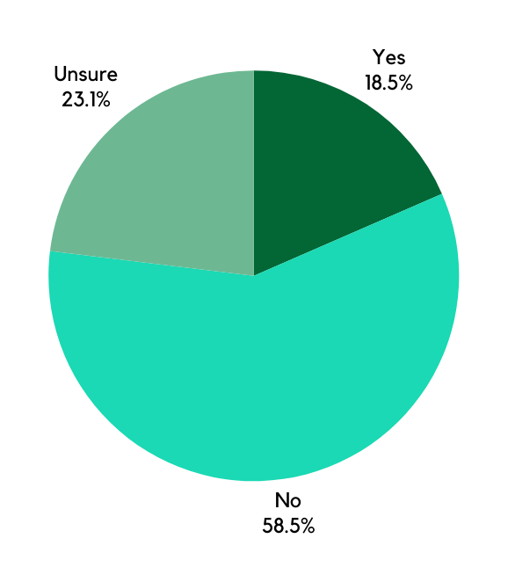
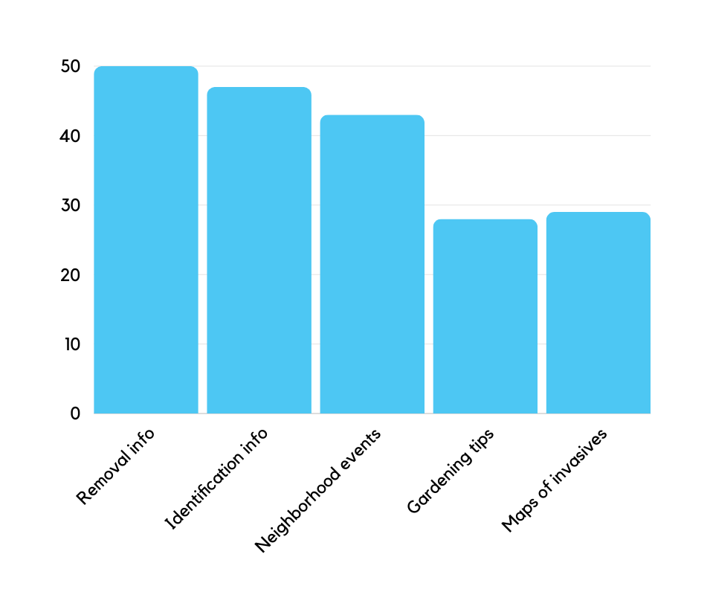
survey
survey results through 6/17:
“Do you have the right tools?”
“What tools do you need?”

Slide 10
1. EVENTS
deliverables
2. EDUCATIONAL MATERIALS
What are possible deliverables from this project?
3. PHYSICAL TOOLS

Slide 11
deliverables
options for deliverables
1. Events
Neighborhood invasive removals
Community events on how to identify and manage invasives
2. Educational materials
How to remove invasives
How to identify invasives
Native/pollinator-friendly gardening tips
Guide to planning neighborhood invasive events
Maps of locations in need of invasive management
3. Physical tools
Hand tools
Gloves
Disposal bags

Slide 12
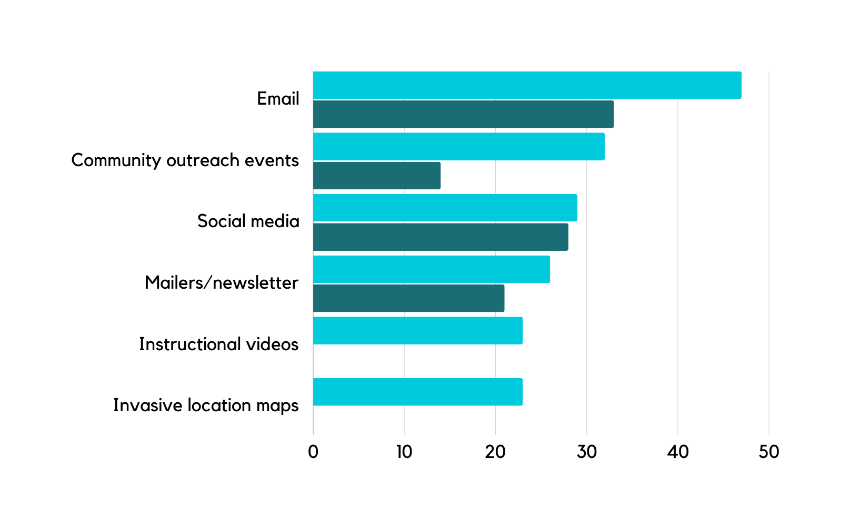
deliverables
methods for delivery
currently used
requested

Slide 13
feedback
What thoughts do you have?

Slide 14
feedback
Questions
What resources do you think will be most helpful to you in invasive plant education and management?
Are there any particular species or locations you feel need more attention?
What would make you more inclined to participate in invasive plant management?

Slide 15
survey

Slide 16
THANK
YOU!
CONTACT:
LEAH SATTLER
651-276-4162
LEAHSATTLERBC@GMAIL.COM
ENGAGE.FAIRFAXVA.GOV/U﻿RBANFORESTMASTERPLAN

