Slide 1
ESC Discussion Options for Collaboration Design Elements and Approaches
Tom Peterson
Chair, ESC
September 17, 2024

Slide 2
Collaboration
the action of working with someone to produce or create something

Slide 3
Look familiar?

Slide 4
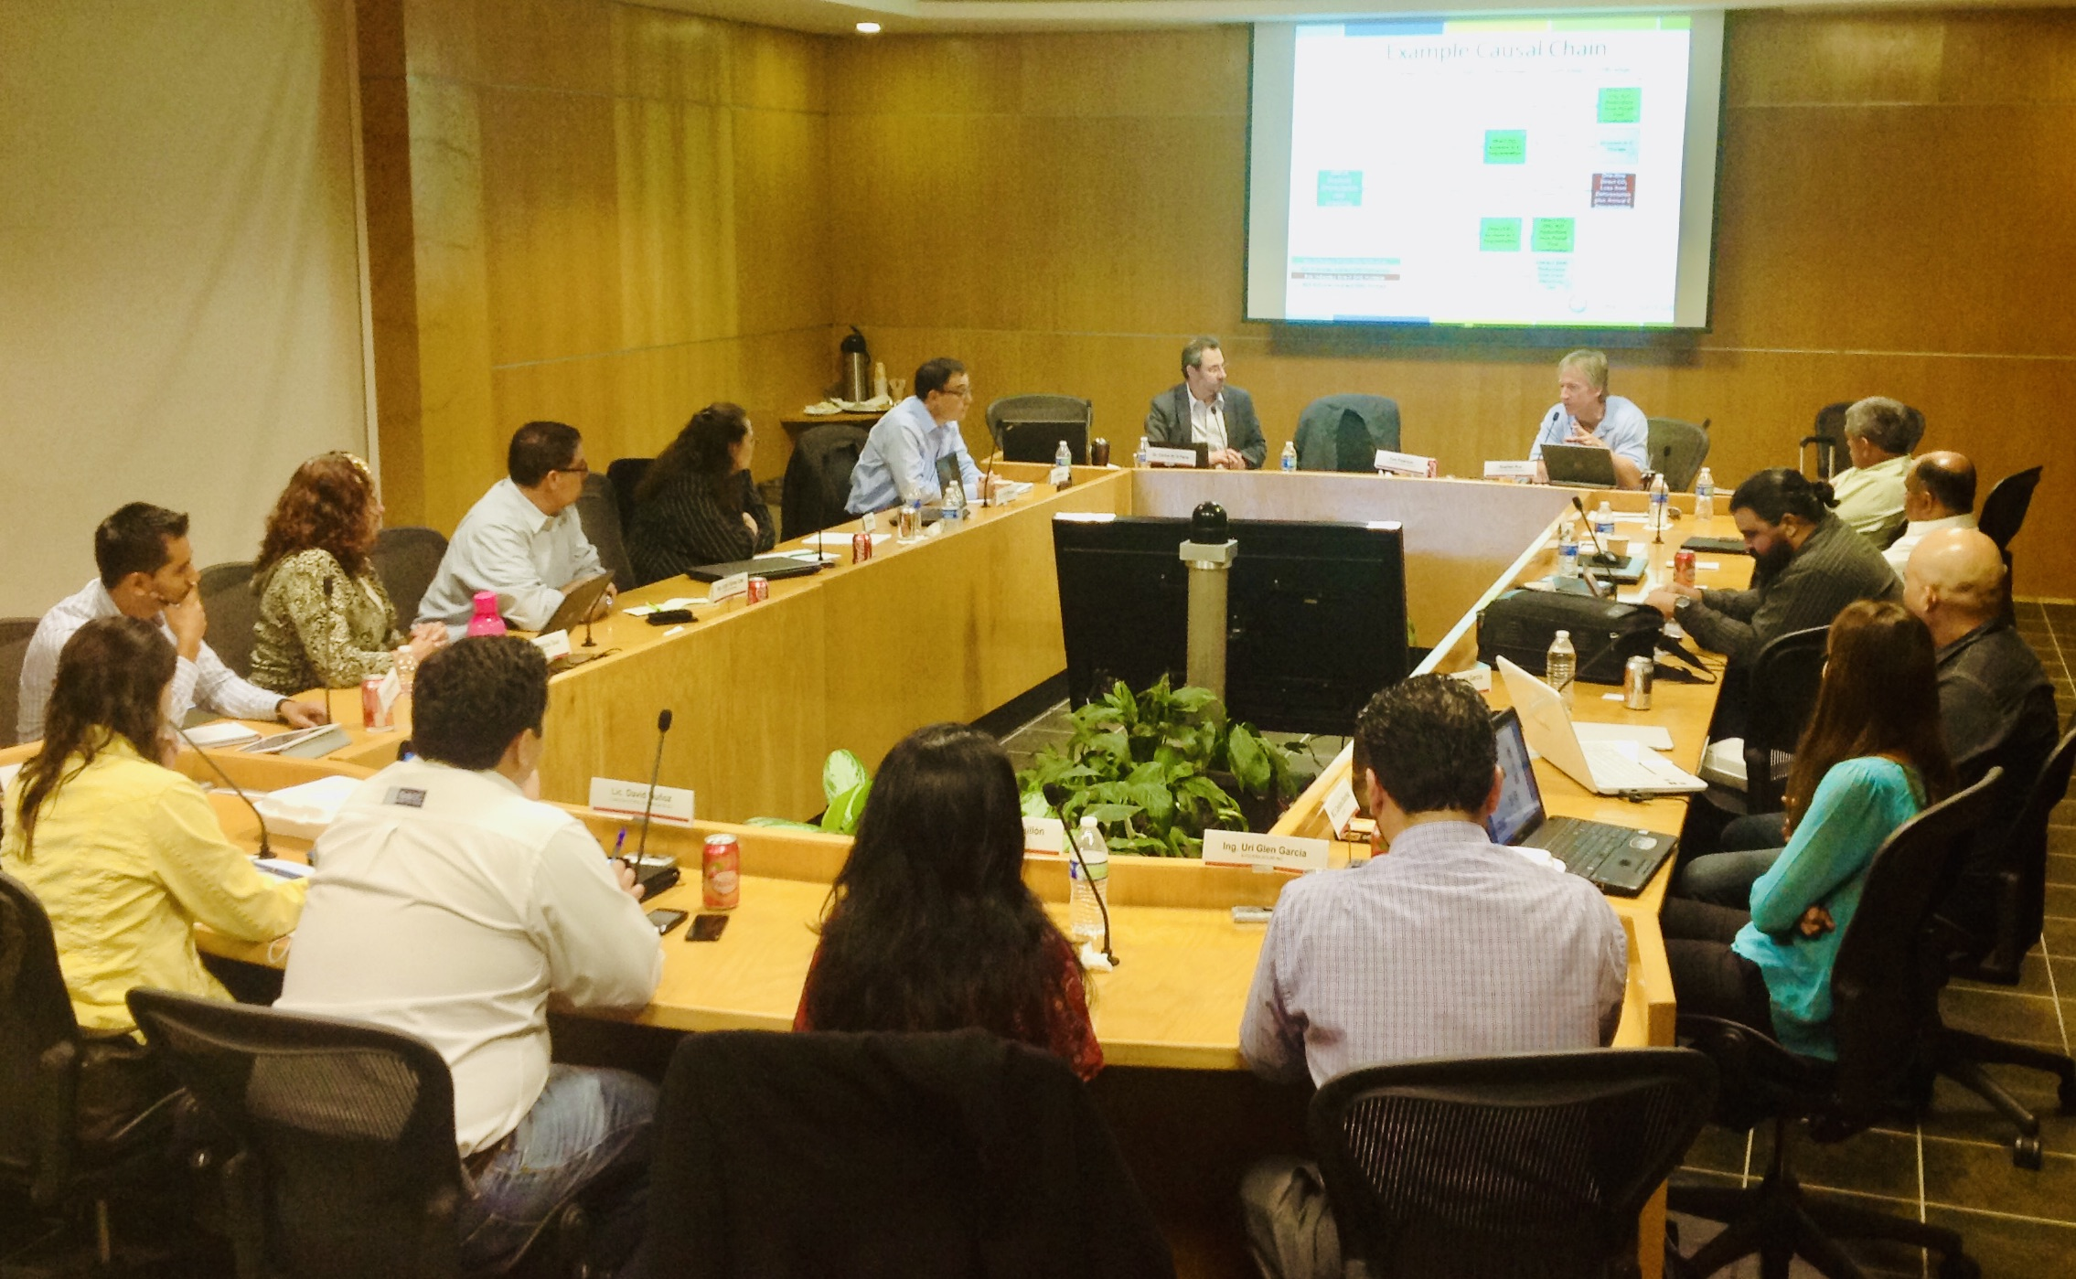
A better way…

Slide 5
Design Elements
Opportunity
Timing
Scope
Participants
Means
Technical assistance
Facilitative assistance
Collaboration mechanisms

Slide 6
Timing (new or existing process)
Early concept stage
Setting goals and objectives
Evaluating business as usual conditions
Identifying options for improvement
Designing, testing, and repeating
Creating final implementation agreement

Slide 7
Scope (focus)
Development
Policies
Plans
Programs
Projects
Budgets
Implementation
Monitoring
Reviews
Updates

Slide 8
Participants
Citizens
Communities
Representative stakeholders
Nongovernmental
Governmental
Boards, commissions, and committees
Appointed officials
Elected officials
Experts
Assistance providers

Slide 9
Means
Technical assistance
Facilitative assistance
Collaboration mechanisms

Slide 10
Technical Assistance
Information
Training
Tools
Education
Capacity building

Slide 11
Facilitative Assistance
Convening
Evaluative facilitation
Collaborative procedures
Group decision support
Group decision making
Conflict resolution

Slide 12
Mechanisms
Method
Co-development and Joint Decisions?
Format
Stature
Tools
Overall Approach
Leadership
Virtual or In person?
Formal or Informal; Binding or Nonbinding?
Quantitative or Qualitative? Reduced form or Full form?
Led by Government or by Third Party?
Single method or Hybrid?
Opportunity
Timing, Scope, and Participants?
Means
Technical and Facilitative Assistance?

Slide 13
Discussion Examples
Urban Forestry
Stormwater Management
Waste Management
Energy Conservation & Efficiency
Food Security
Climate Change
Sustainable Development
Sustainable Transportation

Slide 14
Thank You!
For more information, contact Tom Peterson at tdp1@mac.com

