Slide 1
Kamp Washington Intersection Improvements
City Council Meeting
May 27, 2014
Notes:
FIRST SLIDE

Slide 2
Project Team
City of Fairfax
Virginia Department of Transportation
Rinker Design Associates, P.C. – Consultants
The Public

Slide 3
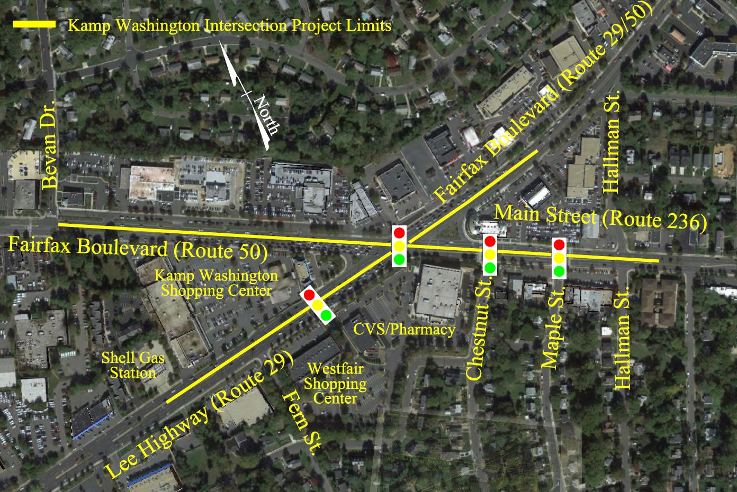
Project Location

Slide 4
Project Scope
Signal improvements
Improved roadway geometrics
Improved pedestrian facilities
Extension of 3rd southbound through lane (Lee Highway)
Extension of 2nd westbound through lane (Main Street)

Slide 5
Schedule
Milestone: Date:
Project Start Fall 2007
Preliminary Design 2007-2009
Public Involvement Phase 2009-2011
Right of Way Acquisition Start Spring 2012
Right of Way Acquisition Complete Spring 2014
Final Design Summer 2014
Utility Relocation Start Summer 2014
Advertise for Construction Fall 2014
Construction Start Spring 2015
Construction Complete Spring 2016

Slide 6
Right of Way Phase Status
19 affected properties requiring acquisition of right of way and/or easements
No business displacements
Agreement reached on 12 parcels
8 Final, 4 Pending
7 outstanding parcels
Negotiations ongoing

Slide 7
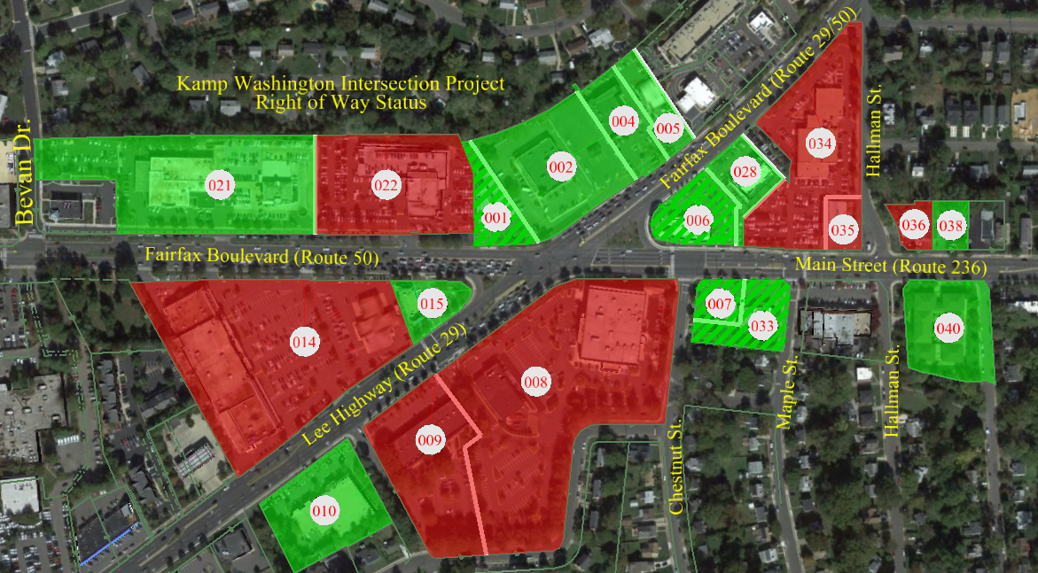
Right of Way Status
Settled
Not Settled

Slide 8
Schedule
Milestone: Date:
Project Start Fall 2007
Preliminary Design 2007-2009
Public Involvement Phase 2009-2011
Right of Way Acquisition Start Spring 2012
Right of Way Acquisition Complete Spring 2014
Final Design Summer 2014
Utility Relocation Start Summer 2014
Advertise for Construction Fall 2014
Construction Start Spring 2015
Construction Complete Spring 2016

Slide 9
Project Cost Estimate
Engineering (PE) : $1.4 M
Right of Way/Utilities: $3.0 M
Construction (CN): $4.4 M
Project Total: $8.8 M

Slide 10
Project Funding
Federal: $7.45 M
State: $1.30 M
Local: $0.05 M
Total $8.80 M

Slide 11
Questions / Comments?

