Slide 1

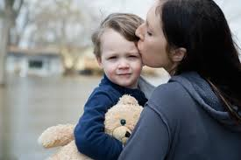
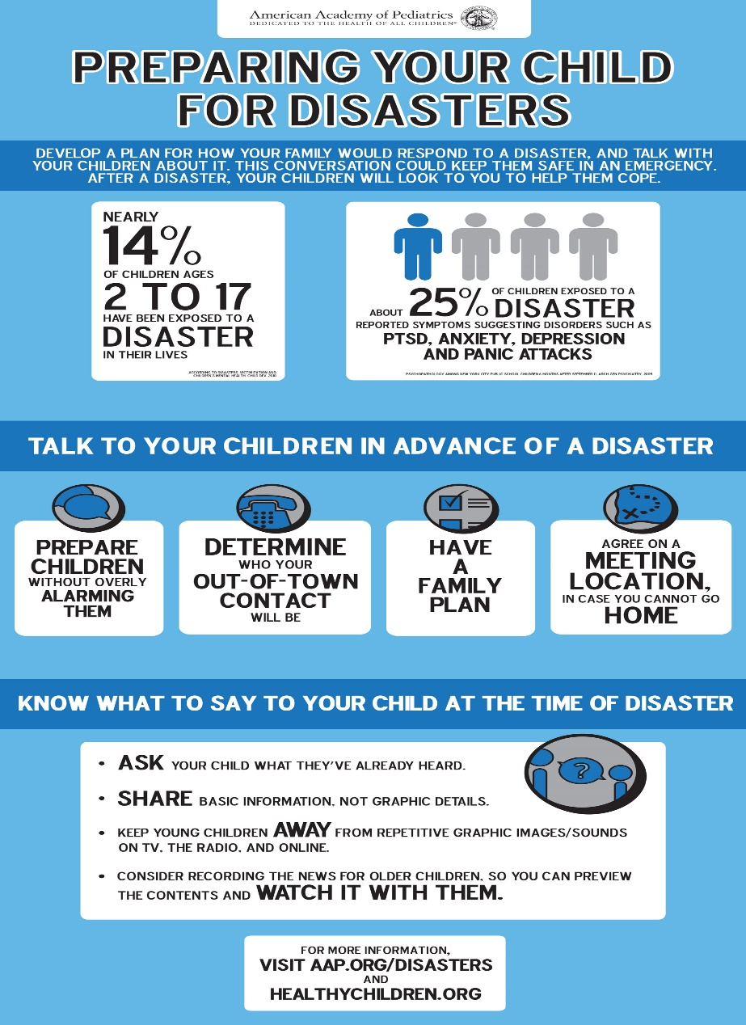

Children in Disasters

Slide 2

Notes:
https://youtu.be/NYmr2U4IXE4
<iframe width="560" height="315" src="https://www.youtube.com/embed/NYmr2U4IXE4" frameborder="0" allowfullscreen></iframe>

Slide 3
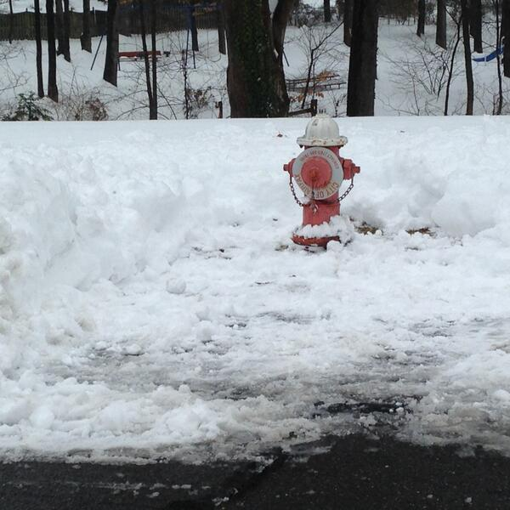
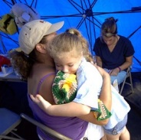
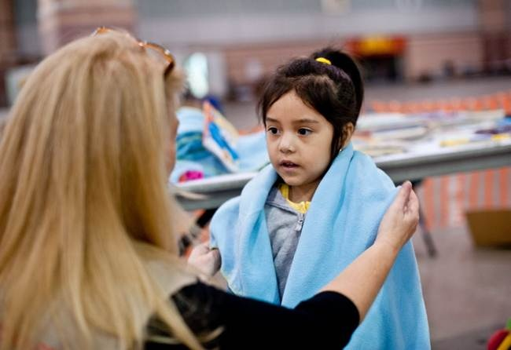
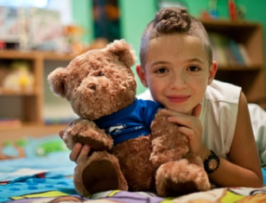
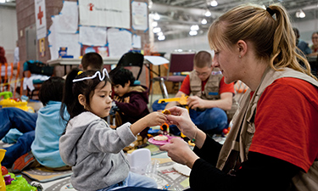
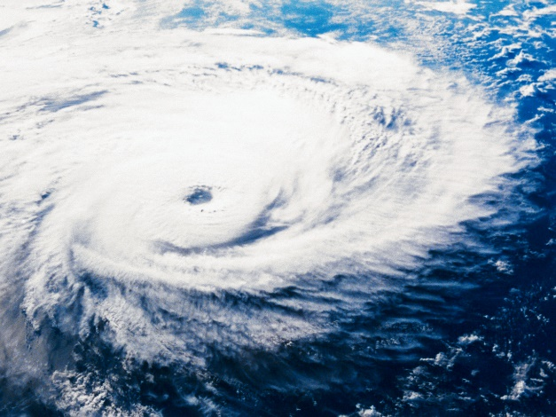
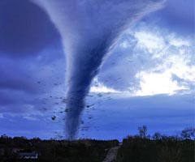
Unique Needs
Notes:
Unique Needs
Children are not simply small adults but have unique vulnerabilities and needs in disasters that should be addressed. For example:
Children may experience long-lasting effects such as academic failure, post-traumatic stress disorder, depression, anxiety, bereavement, and other behavioral problems such as delinquency and substance abuse
During disasters, young children may not be able escape danger, identify themselves, and make critical decisions
Children are dependent on adults for care, shelter, transportation, and protection from predators
Children must be expeditiously reunified with their legal guardians if separated from them during a disaster
Children are often away from parents, in the care of schools, child care providers, Head Start or other child congregate care environments, which must be prepared to ensure children’s safety
Children in disaster shelters require age-appropriate supplies such as diapers, cribs, baby formula, and food
Crisis situations are especially difficult for children emotionally. Often, the perception that children are naturally resilient causes people to expect them to simply bounce back from a disaster
Children are profoundly affected by upheaval in their worlds and need opportunities to share their concerns with other children and caring adults in order to recover from and cope with the effects of a disaster

Slide 4
How Children React (1 of 2)
In a crisis, children have similar feelings to adults. They often show their feelings in actions rather than words.
1–4 years: Thumb-sucking, bedwetting, fear of the dark, clinging to parents, nightmares, not sleeping or broken sleep, loss of bladder or bowel control, speech or feeding problems, fear of being left alone, irritable, fretful
5–10 years: Aggression, confusion, withdrawing, competing for attention, avoiding school, nightmares, poor concentration, tummy aches, headaches, fear of the dark, fear of being hurt or left alone

Slide 5
How Children React (2 of 2)
11–13 years: Changes in appetite, broken sleep, antisocial behavior, school problems, anxiety, aches and pains, skin problems, fear of losing friends and family, acting as if it hasn't happened.
14–18 years: Physical problems (rashes, bowel problems, asthma attacks, headaches), changes in appetite and sleep, lack of interest in things they usually enjoy, lack of energy, antisocial behavior, poor concentration, guilt. Some of these are part of the ups and downs of this age too

Slide 6
Notes:
https://youtu.be/Zig7ecK6r58
<iframe width="560" height="315" src="https://www.youtube.com/embed/Zig7ecK6r58" frameborder="0" allowfullscreen></iframe>

Slide 7
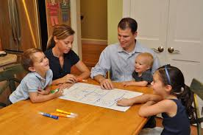
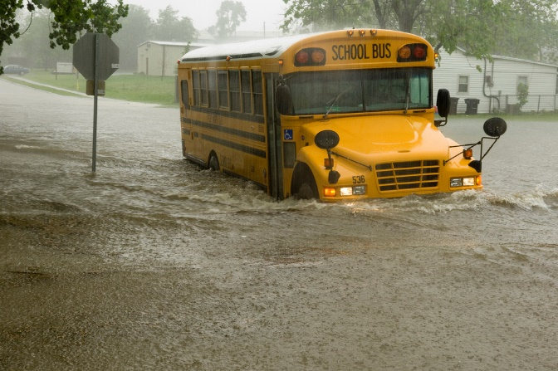
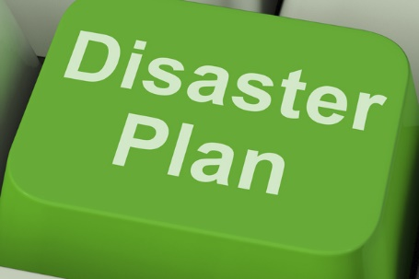
What can we do?
  Prepare a Family Emergency Plan & Go-Kit
  Talk to our children
  Discuss emergency plans at schools, daycare, or other care locations

Slide 8
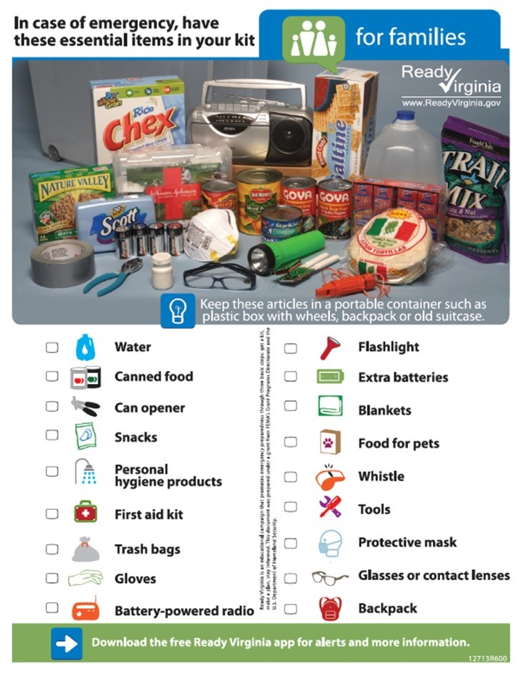
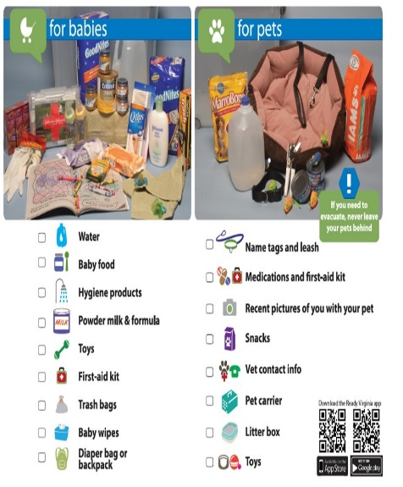
Family Plan & Go-Kit
  Make a Family Plan
    Discuss the plan
    Exercise the plan! Make it fun!
  Discuss what to do if not at home
  Ensure your Go-Kits have kid friendly supplies
Notes:
Consider scavenger hunts around the house for go-kit supplies or make mazes for evacuation training

Slide 9
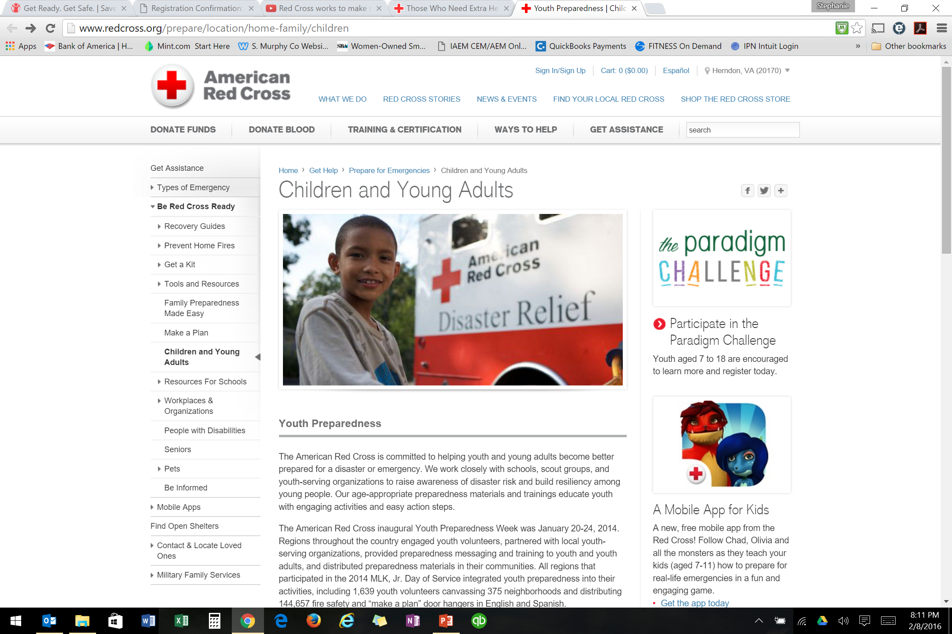
Talk to Children (1 of 3)
  Should a disaster happen:
  Know the facts of the incident
  Understand what your child knows or wants to know
  Offer ideas to be Active following a disaster:
    Volunteer to help others
    Clean up activities
    Visit other kids affected by the disaster

Slide 10
Talk to Children (2 of 3)
The following tips are listed below for helping children during disasters:
Hug your children often and comfort them
Listen to children carefully and give them opportunities to talk about what happened
Limit TV time — news and pictures can be frightening
Watch for changes in your children’s behavior. If your child continues to display disruptions in eating, sleeping or daily activities, or if you as the caregiver feel uncomfortable or concerned, seek assistance from a mental health professional

Slide 11
Talk to Children (3 of 3)
Be patient and understanding — your children might still be upset or frightened
Give your children extra time and attention
Use positive behavior and language around your children
Take care of yourself and do healthy things to relax. Try to get enough rest
Help your children return to school, normal activities and routines
Encourage children to volunteer and help others

Slide 12
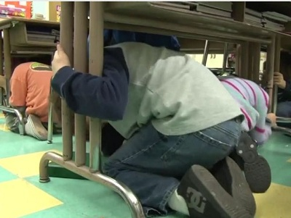

School & Child Care Facilities
Families may become separated during the chaos of a disaster, especially when it necessitates evacuation
A no-notice disaster occurring while children are in schools, afterschool programs, and child care facilities increases the likelihood that children will be separated from parents and guardians
Ask your child’s school, day care, or care facility if they have an emergency plan, how they exercise the plan, and how do they prepare and teach the kids about the plan!

Slide 13
Important phone numbers
EMERGENCIES | 911
City of Fairfax Emergency Management | 703-385-4856
Crisislink Hotline | 703-527-4077
Fairfax County Health Department | 703-246-7100
City of Fairfax Police – Non-emergency | 703-385-7924
City of Fairfax Fire Department - Non-emergency | 703-385-7940
Fairfax Volunteer Fire Department | 703-385-7877
The Virginia Relay Center - TTY | 711
The Virginia Relay Center - Voice | 711
City of Fairfax Police Department - Emergency | 911 or 703-591-5511
Salvation Army | 703-385-8700
American Red Cross | 1-866-438-4636
Department of Homeland Security | 1-800-BE-READY
Center for Disease Control | 1-800-311-3435
National Weather Service | 703-260-0809
FEMA Disaster Assistance Hotline | 1-800-621-3362
FEMA Disaster Assistance Hotline - TTY | 1-800-462-7585
FEMA False Claim Reporting | 1-800-323-9603

Slide 14


Resources
Children in Disasters – American Academy of Pediatrics
https://www.aap.org/en-us/advocacy-and-policy/aap-health-initiatives/Children-and-Disasters/Pages/Hurricanes-Tornadoes-and-Storms.aspx
Healthy Chidlren in Disasters
https://www.healthychildren.org/English/safety-prevention/at-home/Pages/Getting-Your-Family-Prepared-for-a-Disaster.aspx?nfstatus=401&nftoken=00000000-0000-0000-0000-000000000000&nfstatusdescription=ERROR%3a+No+local+token
Save the Children, Get Ready Get Safe
http://www.savethechildren.org/site/c.8rKLIXMGIpI4E/b.8777055/k.18AB/Get_Ready_Get_Safe_Plan_Ahead.htm
City of Fairfax Office of Emergency Management
http://www.fairfaxva.gov/government/emergency-management
Fairfax City Alert
http://fairfaxva.gov/about-us/fairfax-city-alert
Family Communications Plan
http://www.ready.gov/make-a-plan
Get Involved!
Find Out More!

