Slide 1
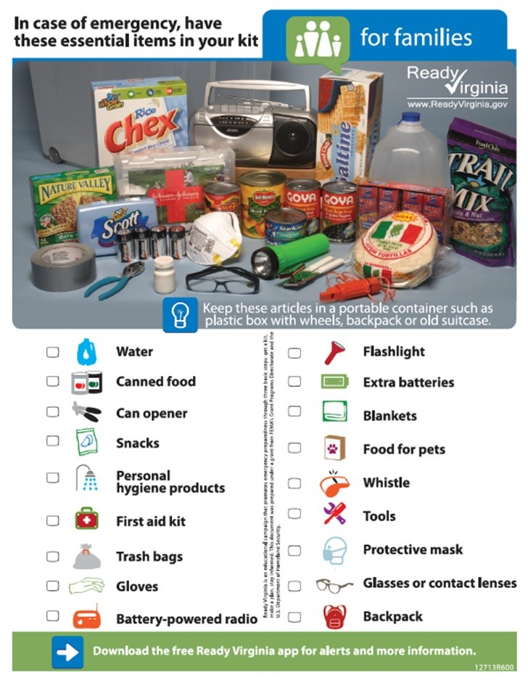

Brown Bag Session
Building an Emergency Kit for Home & Office

Slide 2
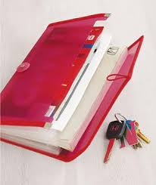
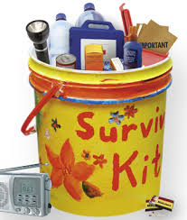
Emergency Kits
Home / Car
Office
Important Documents

Slide 3



Home / Car
Adults
Seniors
Children
Pets
Disabilities, Access & Functional Needs

Slide 4
Home / Car Emergency Kits (1 of 2)
Water—one gallon per person, per day (3-day supply for evacuation, 2-week supply for home)
Food—non-perishable, easy-to-prepare items (3-day supply for evacuation,
2-week supply for home)
Flashlights; Multi-purpose tool; Extra batteries
Battery-powered or hand-crank radio
First aid kit

Slide 5
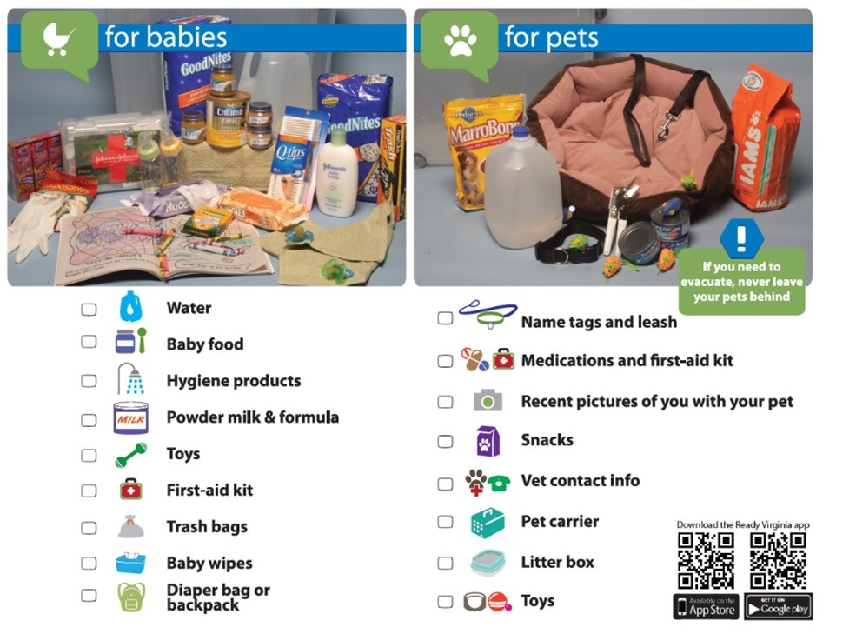
Home / Car Emergency Kits (2 of 2)
Medications (7-day supply) and required medical items
Sanitation and personal hygiene items
Cell phone with chargers
Family and emergency contact information
Extra cash (at least $100/person)
If someone in your home is dependent on electric-powered, life-sustaining equipment, remember to include backup power in your evacuation plan
Important Document Folder / External Drive (electronic copies of documents)

Slide 6
Reminder for
Pets

Slide 7
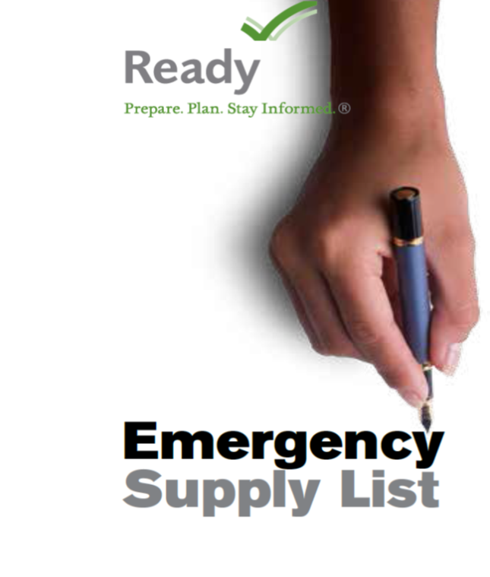
Office (1 of 2)
Office Emergency kits can contain:
  Water, food, blankets
  Comfortable walking shoes (or to be outdoors, walking on debris)
  First Aid Kit, whistle, plastic sheet, duct tape
  Flashlight. Tools, multi-function toolkit or tool
  Hard hat, protective googles, bright colored/reflective vest, towelettes, garbage bags
  Clipboard, pens, pencils, paper

Slide 8
Office (2 of 2)
Each person at work should have a portable emergency supply kit customized to meet their personal needs, such as the inclusion of essential medications.
  Keep copies of important work records in a waterproof, fireproof portable container, such as:
  Site maps, building plans
  Insurance policies, employee contact and identification information, bank account records, supplier and shipping contact lists, computer backups
  Emergency or law enforcement contact information and other priority documents Store a second set of records at an off-site location.
Notes:
When running (continued):
Do not attempt to move wounded people.
Keep your hands visible.
Follow the instructions of any police officers.
Call 911 when it is safe to do so.
Why do police officers need to see your hands when you exit the premises in an active shooter situation?

Slide 9
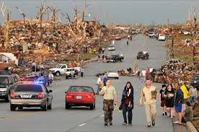
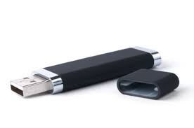

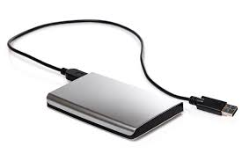
Important Documents
Following an emergency, having your personal documents and contact information easily available can make your recovery quicker and less stressful
Try to have originals; or have pertinent information of where the documents came from (e.g. which courthouse, which County, City, State, etc.)
Grab & Go Files in a Binder OR External Drive (e.g. thumb drive or hard drive)
  Home / Life
  Professional / Business
  Insurance
  Vehicles
  Pets

Slide 10
Emergency Grab & Go Files (1 of 4)
Prove the identity of all household members in a post-disaster situation
  Life documents: birth certificates, social security cards, passports, marriage certificates, death certificates, diplomas / degrees, school records and/or transcripts for all family members; divorce decrees, child support alimony / palimony / child support paperwork
  Drivers License or official State ID; picture of self/family; finger prints
  Advanced Medical Directors / Power of Attorney / Living Wills / Wills
  Religious certificates (e.g. Baptismal Records)
Personal Contacts: Maintain or re-establish contact with your family or other members of your household
Professional / Business Contacts: Maintain contact with your employer or the employers of others in your household

Slide 11
Emergency Grab & Go Files (2 of 4)
Housing payments; other financial obligations (e.g. utility bills, credit card accounts)
  Copies of credit cards front and back
  Deeds and Titles; home improvement documentation and proof; rental agreements
  Repair companies and Points of Contact
  Utility Company Information (e.g. emergency contact, online access info)
  Estate planning documentation
Medical
  Immunization information; medical history; medical records or X-rays
  Medication supply / prescription number information / frequency
  Doctor contact information (e.g. dentist, physician, pediatrician, etc.)
  Disabilities, Access and Functional Needs specific information (e.g. diagnosis, support organizations / centers)

Slide 12
Emergency Grab & Go Files (3 of 4)
Sources of income (e.g. pay stubs); Financial accounts (e.g. checking, savings, or retirement accounts)
  You may need to demonstrate proof of income when you apply for disaster assistance
  Re-establish your financial accounts if checks are destroyed or your regular online access methods are disrupted (ensure you have online login information as well!)
Insurance policies
  Home, business, special policies (jewelry, fire, flood, vehicles)
Vehicle
  Title, registration
  VIN / License Plate Number; Make, model, color
  Service Records
  Picture of vehicle(s)

Slide 13
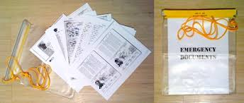
Emergency Grab & Go Files (4 of 4)
Gun registration/licenses if applicable
Tax statements / Records
  W-2s
Provide contact information for actions to start recovery, such as contacting your insurance company to discuss damage and repairs, or contacting utilities regarding outages and restoration
Pets
  Pictures, Breed, Age, Name
  Medical history / records, medications, Microchip info

Slide 14
Resource:
Emergency Financial First Aid Kit (EFFAK)
The FEMA EFFAK is a tool to collect and secure important personal information in a central location
The EFFAK is a useful tool for:
  all income levels and
  whether you live alone or with many others
Available online at www.ready.gov/financialpreparedness or www.operationhope.org; or by calling FEMA at (800) 480–2520 (ask for document #532)

Slide 15
Important phone numbers
EMERGENCIES | 911
City of Fairfax Emergency Management | 703-385-4856
Crisislink Hotline | 703-527-4077
Fairfax County Health Department | 703-246-7100
City of Fairfax Police – Non-emergency | 703-385-7924
City of Fairfax Fire Department - Non-emergency | 703-385-7940
Fairfax Volunteer Fire Department | 703-385-7877
The Virginia Relay Center - TTY | 711
The Virginia Relay Center - Voice | 711
City of Fairfax Police Department - Emergency | 911 or 703-591-5511
Salvation Army | 703-385-8700
American Red Cross | 1-866-438-4636
Department of Homeland Security | 1-800-BE-READY
Center for Disease Control | 1-800-311-3435
National Weather Service | 703-260-0809
FEMA Disaster Assistance Hotline | 1-800-621-3362
FEMA Disaster Assistance Hotline - TTY | 1-800-462-7585
FEMA False Claim Reporting | 1-800-323-9603

Slide 16


Resources
City of Fairfax Office of Emergency Management
http://www.fairfaxva.gov/government/emergency-management
Fairfax City Alert
http://fairfaxva.gov/about-us/fairfax-city-alert
Ready Virginia
http://www.vaemergency.gov/readyvirginia
Individuals with Disabilities, Access and Functional Needs
https://www.ready.gov/individuals-access-functional-needs
Family Communications Plan
http://www.ready.gov/make-a-plan
Coloring books for Kids
http://www.nssl.noaa.gov/education/students/
Get a Kit, Ready Virginia
http://www.vaemergency.gov/readyvirginia/getakit
Ready.Gov (FEMA)
http://www.ready.gov/
Get Involved!
Find Out More!

